Slide 1
Current Affairs Video
Name
Institution
Date

Slide 2

Introduction
The current affairs video is about how the U.S. successfully responded to the economic ravages of the COVID-19 pandemic.
The article featured on the Wall Street Journal website on September 15, 2021
The COVID-19 pandemic has been the worst economic hit after the Great Depression.
As a result of the financial crisis caused by the pandemic, both employment and output declined more than in 2008 during the Great depression (Ip, 2021).
Notes:
The current affairs video is about an article of how the United States successfully responded to the economic ravages caused by the current COVID-19 pandemic. The article was published on the Wall Street Journal website on September 15, 2021 (Ip, 2021). The COVID-19 pandemic has been the worst economic hit in the U.S. after the Great Depression, and it has caused a significant financial crisis. Notably, as a result of the financial crisis caused by the pandemic, both employment and output declined more than in 2008 during the Great depression (Ip, 2021). However, the fiscal policy crafted by the U.S. government has been successful in responding to the economic effects of the pandemic.

Slide 3
Arguments
The main argument is the economic policy response to the COVID-19 pandemic
The Federal Reserve reduced interest rates to nearly zero
Congress approved 5.9 trillion dollars to cater for emergency measures
Small businesses that retained their employees received forgivable loans
Expansion of unemployment insurance to include gig workers (Ip, 2021)
Notes:
The primary argument in this article is the economic policy response to the COVID-19 pandemic. Notably, in order to respond to the economic crisis caused by the pandemic, the Federal Reserve reduced interest rates to nearly zero and also made an intervention in markets so as to ensure that the economic crisis did not progress to a financial crisis. There was a variety of other measures made to respond to the pandemic economically. Such measures include Congress approving 5.9 trillion dollars to cater for emergency measures, small business enterprises that retained their employees receiving forgivable loans, and the expansion of the unemployment insurance to include gig workers (Ip, 2021).

Slide 4
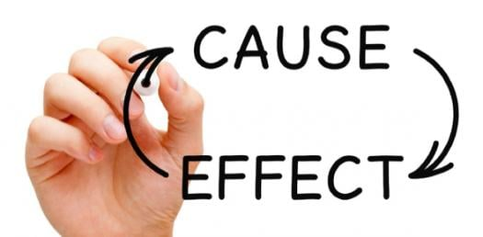
Concepts in the Article
Some of the concepts learned in class, and that features in the article include;
  Credibility
  Cause and effect reasoning
  Rhetoric devices
The writer used deductive reasoning (Ip, 2021)
Notes:
Various concepts learned in class featured in this article. Credibility is the state of being trustworthy. The information presented in the article is credible because it was from government sources like the Committee for a Responsible Federal Budget. Cause and effect reasoning is whereby one event leads to a specific outcome or another event (Moore & Parker, 2017). An example of cause and effect reasoning is when the writer notes that long-term unemployment, as well as depressed sales, causes both business and human capital to reduce. Rhetoric devices are linguistic tools used in literature for eliciting reactions from the audience. A rhetoric device used in the article is repetition, whereby the phrase "stimulus checks" was repeated severally. Deductive reasoning is the use of general statements to arrive at logic or a specific conclusion. An example of deductive reasoning in the article is "Whatever its other benefits, insurance that pays more than the lost job discourages work" (Ip, 2021).

Slide 5
Why the Argument Fits these Concepts
Cause and effect reasoning is used to explain the impact of unemployment as well as depressed sales.
Credibility is used to show trustiness of the presented information
Repetition is used to draw the attention of the readers
All these concepts strengthen the main argument (Ip, 2021)
Notes:
The main argument in the article fits well the above concepts. For example, cause and effect reasoning is used in the article to explain the impact of as well as depressed sales. Notably, unemployment, as well as depressed sales caused by the COVID-19 pandemic, causes a reduction in both business and human capital (Ip, 2021). Credibility is used to show the trustworthiness of the presented information. It is highly likely that information in government sources is accurate and thus credible. Speakers or writers use rhetorical devices like repetition so as to draw the attention of their listeners or readers. The main aim of these concepts was to strengthen the main argument of the article.

Slide 6
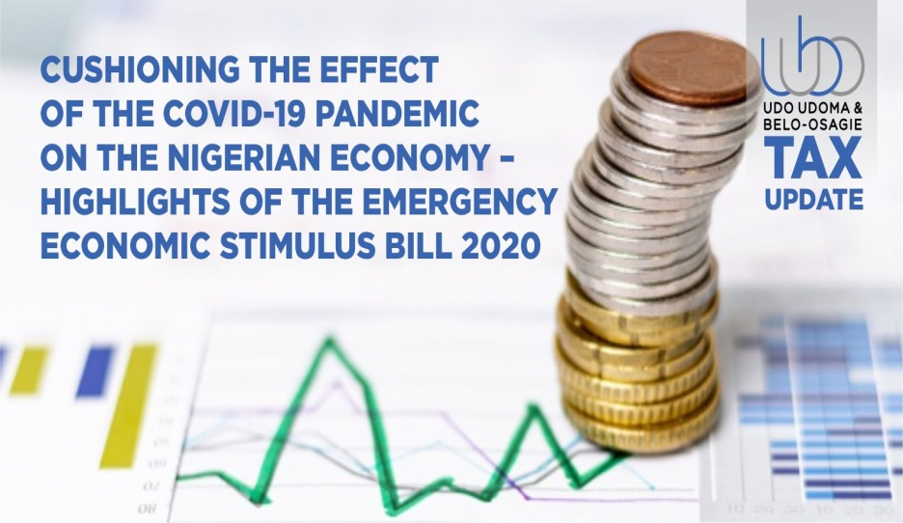
Conclusion
The primary argument of the article is very convincing
I support the economic response from the government
Governments should support their citizens in times of pandemics
Economic cushioning from the government against the economic impacts of pandemics helps citizens to meet basic needs
Notes:
The primary argument of the article is very convincing. Pandemics like the COVID-19 cause significant economic crises that, if not well addressed, may result in financial crises. Therefore, an economic response from governments is always appropriate. I support the economic response from the government because it is a way of cushioning citizens against the economic effects of the pandemic. Governments should stand with their people in times of pandemics. Economic cushioning in time of pandemics helps citizens to meet their basic needs.

Slide 7
References
Ip, G. (2021). How the U.S. Nailed the Economic Response to Covid-19. The Wall Street Journal. Retrieved from https://www.wsj.com/articles/how-the-u-s-nailed-the-economic-response-to-covid-19-11631714400
Moore, B.N., & Parker, R. (2017). Critical Thinking. McGraw-Hill Education.

